Slide 1


CAPSTONE PROJECT
Sales Analysis Dashboard for Amazon Products using Power BI
Presented By
Student Name:Harshal Jadhav
College Name: D Y Patil college of
engineering , Akurdi , pune
Department: Information technology
Email ID:harshalj96k@gmail.com

Slide 2
OUTLINE:
Problem Statement (Should not include solution)
Proposed System/Solution
System Development Approach (Technology Used)
Algorithm & Deployment
Result (Output Image)
Conclusion
Future Scope
References

Slide 3
Problem Statement:
E-commerce platforms such as Amazon generate large volumes of sales data from different product categories, customer reviews, and purchase transactions. Analyzing this massive amount of data manually is difficult and time-consuming.
Businesses often struggle to understand key insights such as which products perform best, how sales change over time, and how different product categories contribute to overall revenue.
Without proper data analysis, it becomes challenging for organizations to make strategic decisions related to product performance, marketing strategies, and inventory management.
Therefore, there is a need to analyze sales data effectively to identify trends, patterns, and key business insights.

Slide 4
Proposed Solution:
The proposed system is a Sales Analysis Dashboard developed using Power BI that analyzes Amazon product sales data and presents it through interactive visualizations.
The system processes the dataset and displays important business metrics such as sales performance, product category distribution, and product reviews. The dashboard allows users to analyze data through multiple visual charts including monthly sales trends, weekly sales patterns, and top-performing products.
Interactive filters enable users to explore specific product categories and gain deeper insights into sales performance.
This dashboard helps businesses quickly understand sales trends and make data-driven decisions.

Slide 5
System Approach:
The system was developed using Business Intelligence and Data Visualization techniques.
Main technologies used:
Power BI Desktop Used to create interactive dashboards and visualizations.
CSV Dataset Used as the data source containing Amazon product sales information.
Power Query Editor Used for data cleaning and transformation.
Data Visualization Techniques
KPI Cards
Line Charts
Bar Charts
Donut Charts
Map Visualization
Filters and Slicers
These technologies enable efficient analysis and presentation of complex datasets.

Slide 6
Algorithm & Deployment:
Algorithm
The following steps were followed to develop the dashboard:
Import the Amazon product sales dataset into Power BI.
Clean and preprocess the dataset using Power Query Editor.
Create calculated measures such as Total Sales, Products Sold, and Reviews.
Design visualizations including sales trends, category distribution, and product rankings.
Add filters and slicers to allow interactive data analysis.
Arrange visual elements to create an interactive dashboard layout.
Deployment
The dashboard can be deployed in multiple ways:
Published on Power BI Service for online access
Shared with users through Power BI workspace
Exported as reports or screenshots for presentations
This allows businesses and analysts to access the dashboard easily.

Slide 7
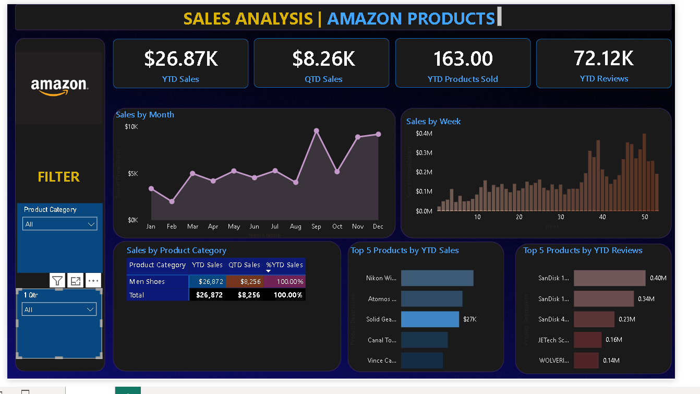
Result:

Slide 8
Conclusion:
This project demonstrates the use of Power BI as an effective business intelligence tool for analyzing sales data.
By transforming raw Amazon product data into an interactive dashboard, the project helps users easily identify trends, top-performing products, and sales patterns.
The dashboard enables better decision-making by providing clear visual insights and improving the understanding of business performance.
Thus, Power BI proves to be a powerful platform for data analysis and visualization.

Slide 9
Future scope:
The project can be further improved with the following enhancements:
Integration with real-time sales data from e-commerce platforms
Implementation of machine learning models for sales prediction
Addition of customer behavior and sentiment analysis
Development of mobile-friendly dashboards
Integration with cloud databases and enterprise systems
These improvements can enhance the analytical capabilities of the dashboard.

Slide 10
References:
Microsoft Power BI Documentation https://powerbi.microsoft.com
Microsoft Learn – Power BI Tutorials https://learn.microsoft.com/power-bi
Power BI Dashboard Tutorial (YouTube)
Amazon Product Sales Dataset (Public Dataset)
Google Drive Link : https://drive.google.com/drive/folders/1X8IlLarGMnjwvOxpic26UgGA8Qpw4SzD?usp=drive_link
GitHub Link: https://github.com/HarshalJ96k/MS-ELEVATE-INTERNSHIP

Slide 11
Thank You

